Slide 1

Exploratory Data Analysis
Customer Segmentation

Slide 2

Agenda
Team Introduction
Problem Statement
EDA Analysis
Recommendations

Slide 3
Team Members
Ray Ng
rayng2018@gmail.com
Canada
University of British Columbia
Specialization: Data Science
Rita Uzoka
rita.uzoka@yahoo.com
United Kingdom
Sheffield Hallam University
Specialization: Data Science
Fatemeh Bagheri
f.bagheri13@gmail.com
France
Université Jean Monnet St Etienne - Université de Lyon
Your Specialization: Data Science

Slide 4
Problem
Customer Segmentation
XYZ bank wants to roll out Christmas offers to their customers. But the bank does not want to roll out the same offer to all customers, instead they want to roll out personalized offers to particular sets of customers. If they manually start understanding the category of customer then this will not be efficient and also they will not be able to uncover the hidden pattern in the data ( pattern which groups certain kinds of customer in one category). Bank approached ABC analytics company to solve their problem. Bank also shared information with ABC analytics that they don't want more than 5 groups as this will be inefficient for their campaign.

Slide 5
What kind of data does each column hold in the raw data?
Unnamed: 0: [ 0 1 2 ... 999997 999998 999999]
fecha_dato: ['2015-01-28' '2015-02-28']
ncodpers: [1375586 1050611 1050612 ... 1149999 1150908 1183305]
ind_empleado: ['N' nan 'A' 'B' 'F' 'S']
pais_residencia: ['ES' nan 'CA' 'CH' 'CL' 'IE' 'AT' 'NL' 'FR' 'GB' 'DE' 'DO' 'BE' 'AR' 'VE'
'US' 'MX' 'BR' 'IT' 'EC' 'PE' 'CO' 'HN' 'FI' 'SE' 'AL' 'PT' 'MZ' 'CN'

Slide 6
How many NA are in each column?
Unnamed: 0: 0
fecha_dato: 0
ncodpers: 0
ind_empleado: 10782
pais_residencia: 10782
sexo: 10786
age: 10782
fecha_alta: 10782
ind_nuevo: 10782
antiguedad: 10782
indrel: 10782
ult_fec_cli_1t: 998899
indrel_1mes: 10782

Slide 7
Table 1 – some rows which have many NA
 | Unnamed: 0 | fecha_dato | ncodpers | ind_empleado | pais_residencia | sexo | age | fecha_alta | ind_nuevo | antiguedad | ... | ind_hip_fin_ult1 | ind_plan_fin_ult1 | ind_pres_fin_ult1 | ind_reca_fin_ult1 | ind_tjcr_fin_ult1 | ind_valo_fin_ult1 | ind_viv_fin_ult1 | ind_nomina_ult1 | ind_nom_pens_ult1 | ind_recibo_ult1
261 | 261 | 2015-01-28 | 1050741 | NaN | NaN | NaN | NaN | NaN | NaN | NaN | ... | 0 | 0 | 0 | 0 | 0 | 0 | 0 | 0.0 | 0.0 | 0
1029 | 1029 | 2015-01-28 | 1051017 | NaN | NaN | NaN | NaN | NaN | NaN | NaN | ... | 0 | 0 | 0 | 0 | 0 | 0 | 0 | 0.0 | 0.0 | 0
1063 | 1063 | 2015-01-28 | 1051064 | NaN | NaN | NaN | NaN | NaN | NaN | NaN | ... | 0 | 0 | 0 | 0 | 0 | 0 | 0 | 0.0 | 0.0 | 0
1154 | 1154 | 2015-01-28 | 1051387 | NaN | NaN | NaN | NaN | NaN | NaN | NaN | ... | 0 | 0 | 0 | 0 | 0 | 0 | 0 | 0.0 | 0.0 | 0
1779 | 1779 | 2015-01-28 | 1048660 | NaN | NaN | NaN | NaN | NaN | NaN | NaN | ... | 0 | 0 | 0 | 0 | 0 | 0 | 0 | 0.0 | 0.0 | 0
... | ... | ... | ... | ... | ... | ... | ... | ... | ... | ... | ... | ... | ... | ... | ... | ... | ... | ... | ... | ... | ...

Slide 8
Correlation of selected variables
 | Unnamed: 0 | ncodpers | ind_nuevo | indrel | indrel_1mes | tipodom | cod_prov | ind_actividad_cliente | renta | ind_ahor_fin_ult1 | ... | ind_hip_fin_ult1 | ind_plan_fin_ult1 | ind_pres_fin_ult1 | ind_reca_fin_ult1 | ind_tjcr_fin_ult1 | ind_valo_fin_ult1 | ind_viv_fin_ult1 | ind_nomina_ult1 | ind_nom_pens_ult1 | ind_recibo_ult1
Unnamed: 0 | 1.000000 | -0.447119 | 0.008312 | -0.007374 | -0.000538 | NaN | 0.035614 | 0.116265 | 0.044528 | 0.005893 | ... | 0.043927 | 0.048669 | 0.029035 | 0.092628 | 0.082870 | 0.077629 | 0.035114 | 0.069204 | 0.074190 | 0.080595
ncodpers | -0.447119 | 1.000000 | 0.002898 | 0.011554 | 0.001253 | NaN | -0.040761 | -0.187022 | -0.088417 | -0.013469 | ... | -0.100045 | -0.125874 | -0.027066 | -0.189129 | -0.190208 | -0.177782 | -0.073552 | -0.138254 | -0.152622 | -0.163071
ind_nuevo | 0.008312 | 0.002898 | 1.000000 | 0.026681 | 0.268051 | NaN | -0.000279 | 0.008165 | -0.000986 | -0.000296 | ... | -0.002224 | -0.002701 | -0.001432 | -0.003034 | -0.004998 | -0.004265 | -0.001789 | -0.004081 | -0.004497 | -0.005767
indrel | -0.007374 | 0.011554 | 0.026681 | 1.000000 | 0.004462 | NaN | 0.001728 | -0.030518 | -0.000745 | -0.000447 | ... | -0.002745 | -0.003067 | -0.001219 | -0.005014 | -0.005641 | -0.003062 | -0.002699 | -0.005771 | -0.005919 | -0.005887
indrel_1mes | -0.000538 | 0.001253 | 0.268051 | 0.004462 | 1.000000 | NaN | -0.000779 | -0.000859 | 0.000615 | -0.000088 | ... | -0.000659 | -0.000800 | -0.000424 | -0.001801 | -0.001127 | -0.001333 | -0.000530 | -0.000162 | -0.000319 | -0.000852
tipodom | NaN | NaN | NaN | NaN | NaN | NaN | NaN | NaN | NaN | NaN | ... | NaN | NaN | NaN | NaN | NaN | NaN | NaN | NaN | NaN | NaN

Slide 9
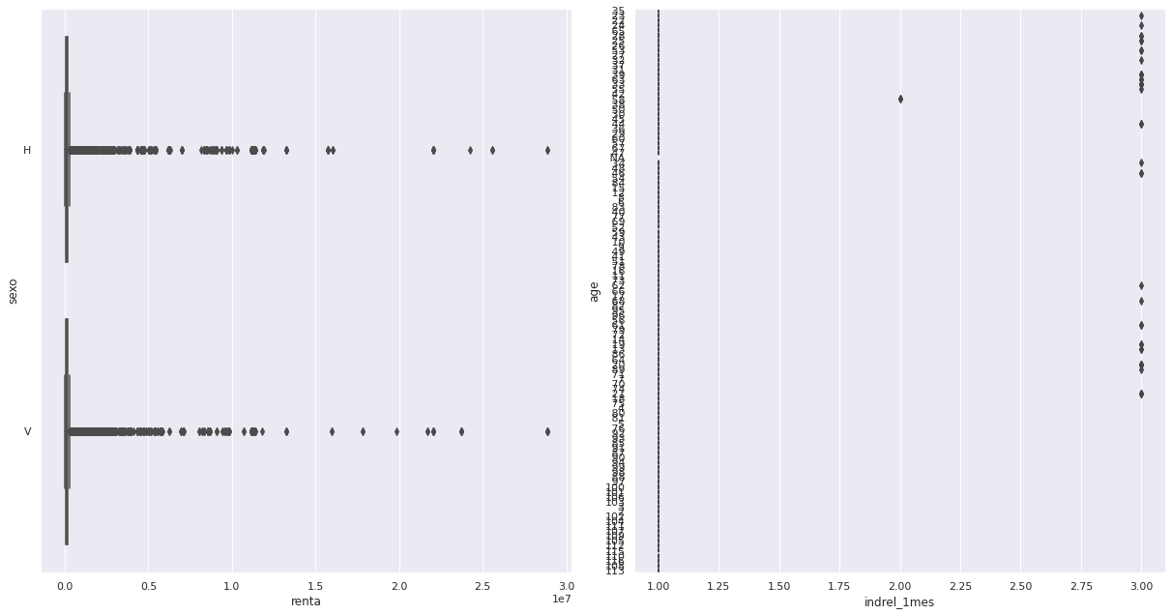
Outliers in numerical data

Slide 10
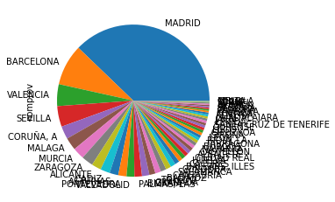
Share of customers by province

Slide 11
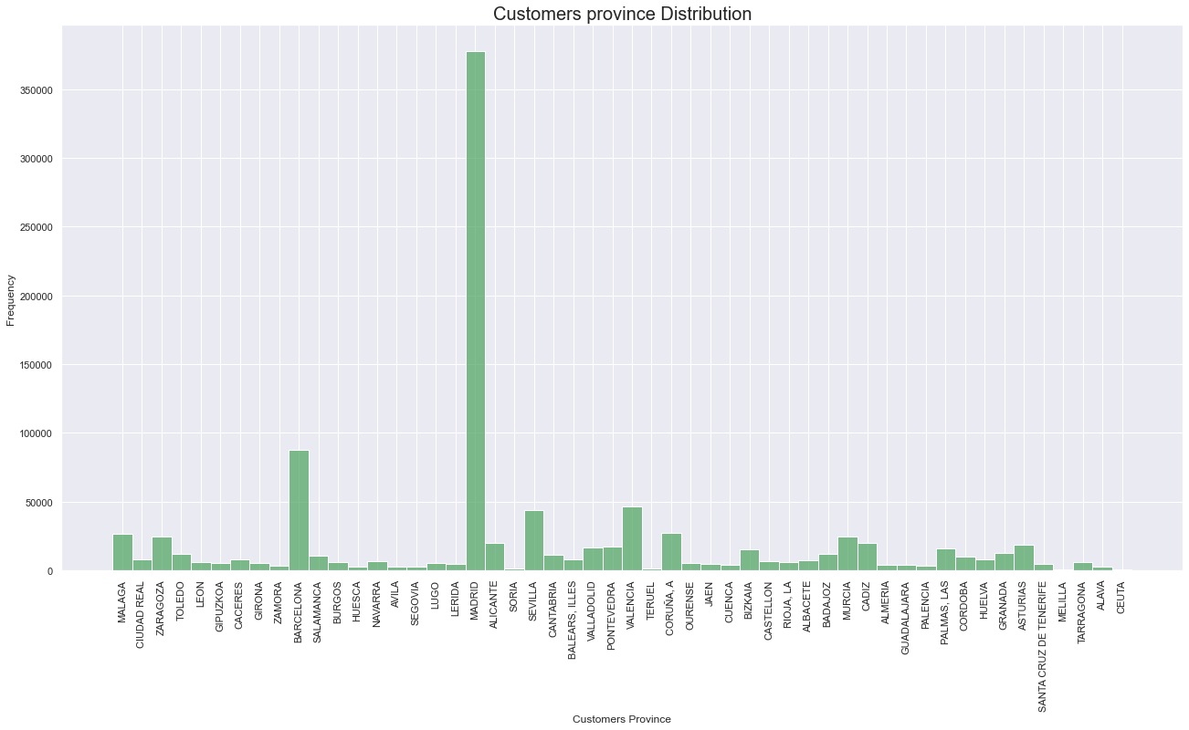
Share of customers by province

Slide 12
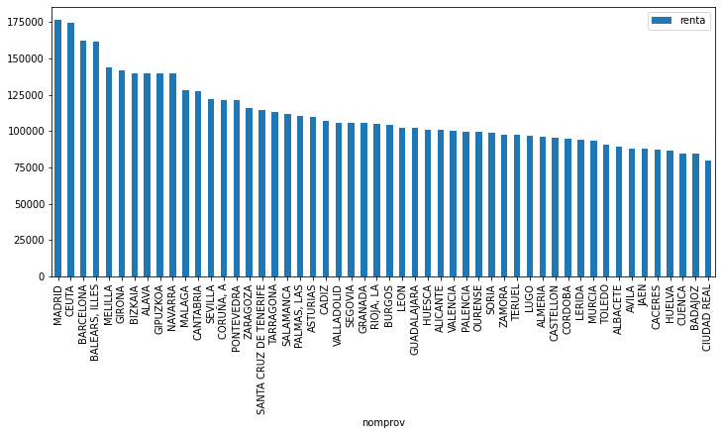
Average household income by province

Slide 13
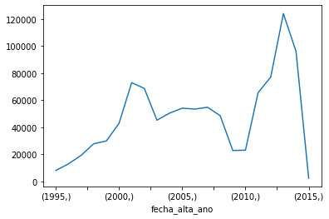
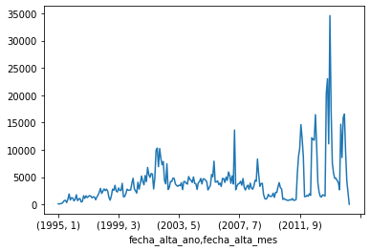
Monthly and Annual Trends in Customer Registration
Number of customer registrations by year and by month. Note that the period after 2011 has more registrations compared to before.

Slide 14
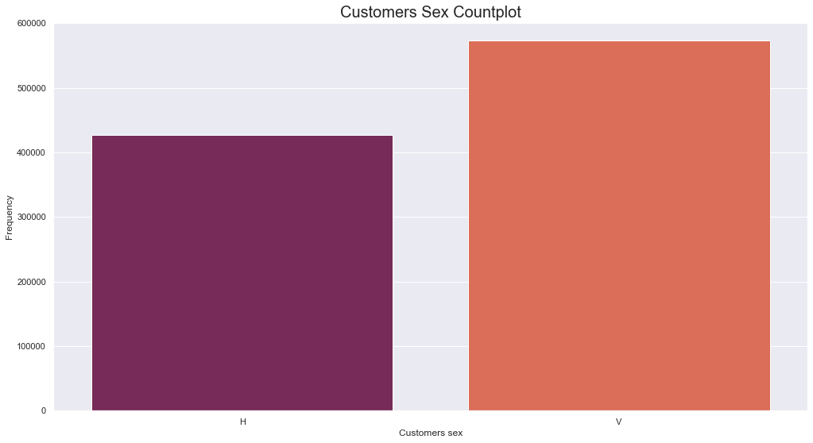
Customers Sex Category Distribution
Most of the customers belong to the sex category “V”.

Slide 15
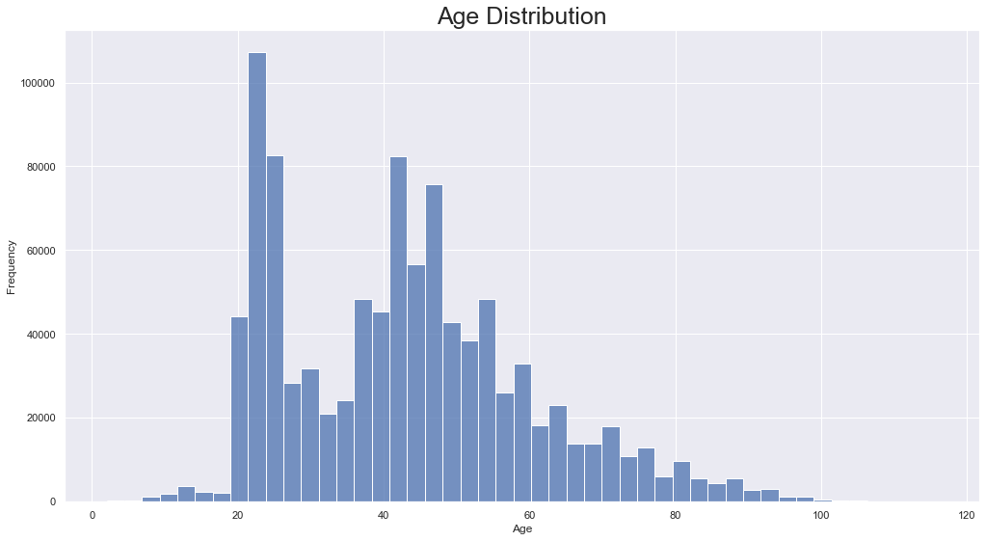
Customers Age Distribution

Slide 16
Recommendation
We recommend to create a customer segment specially for the Madrid province residents and separately for residents outside Madrid, considering that they make up the largest group of customers and have a higher household income than other provinces.
Another segment would be for customers who have registered from 2011, as the customers from those years represent a relatively large portion of customers compared to those from previous years.
A sex category segment for customers will be appropriate as well. (Not sure if this is very appropriate - is this discrimination? I dont think its discrimination because we have a separate column that specifies the sex of all the customers,this is necessary because one wouldnt want christmas package designed for sex “v” to be going to Sex “h” remember it is a personalized christmas package ,I think the company should have alot of varieties for future purposes as well.)
Customer Demographic Segment: a segment for customers and their respective province.

Slide 17
Thank You

